Slide 1




KS4 Mathematics
S9 Constructing Triangles

Slide 2
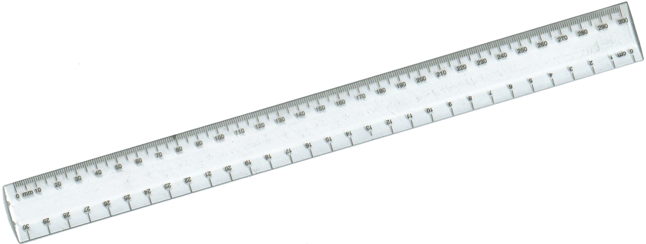
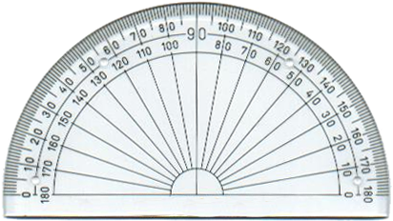
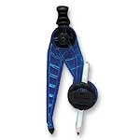


Equipment needed for constructions
Before you begin make sure you have the following equipment:
A ruler marked in cm and mm
A protractor
A sharp pencil
A pair of compasses
Notes:
Constructions should be drawn in pencil and construction lines should not be rubbed out.

Slide 3
Constructing triangles
To accurately construct a triangle you need to know:
The length of two sides and the included angle (SAS)
The size of two angles and a side (ASA)
The lengths of three of the sides (SSS)
Or
A right angle, the length of the hypotenuse and the length of one other side (RHS)

Slide 4
Constructing a triangle given SAS
How could we construct a triangle given the lengths of two of its sides and the angle between them?
side
angle
side
The angle between the two sides is often called the included angle.
We use the abbreviation SAS to stand for Side, Angle and Side.
Notes:
Discuss how this could be constructed using a ruler and a protractor.

Slide 5
Constructing a triangle given ASA
How could we construct a triangle given two angles and the length of the side between them?
angle
angle
side
The side between the two angles is often called the included side.
We use the abbreviation ASA to stand for Angle, Side and Angle.
Notes:
Point out that if we are given two angles in a triangle we can work out the size of the third angle using the fact that the angles in a triangle add up to 180°. If the side we are given is not the included side then we can work out the third angle.
Discuss how this triangle could be constructed using a ruler and a protractor.

Slide 6
Constructing a triangle given SSS
How could we construct a triangle given the lengths of three sides?
side
side
side
Hint: We would need to use a compass.
We use the abbreviation SSS to stand for Side, Side, Side.
Notes:
Discuss how this triangle could be constructed using a ruler and a compass.

Slide 7
Constructing a triangle given RHS
Remember, the longest side in a right-angled triangle is called the hypotenuse.
How could we construct a right-angled triangle given the right angle, the length of the hypotenuse and the length of one other side?
hypotenuse
right angle
side
We use the abbreviation RHS to stand for Right angle, Hypotenuse and Side.

